Slide 1

Stock Selection
with
a Simple Multi-factor Model
Group J
Jack, WU CHAN KEONG
Anita, ZENG JINGYI
Izzie, CHEN XI

Slide 2



Introduction
Topic INTRODUCYION
Python Library
Data Loading and Cleaning
Data Processing and Analysis
Conclusion
improvement

Slide 3

TOPIC INTRODUCYION

Slide 4



Multi-factor stock selection models
Find a series of factors related to stock prices, use quantitative methods to model and select stocks.
Portfolio objectives
Outperform Hang Seng Index(HSI)
stock picks
Hong Kong stock

Slide 5
Python Library

Slide 6


numpy
pandas
yfinance
matplotlib
threading
logging

Slide 7
Data Loading and Cleaning

Slide 8
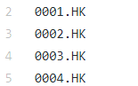

Download and filter stocks list from Hong Kong Stock Exchange website
Keep only the stock symbols of those companies and saved it as csv file.
Batch download current financial info from Yahoo
Divide several threads for downloading synchronously in the background
Use logging to track the execution of each thread
Collect status information and save as a logfile for follow-up review and debugging
yfinance

Slide 9
Data Processing and Analysis

Slide 10
Factors choosing
Value Factor
Size Factor
Growth Factor
price-to-book ratio
(PB ratio)
shares outstanding
earnings quarterly growth
High PB ratio represents that the quality of corporates’ assets is better and corporates have development potentials.
High shares outstanding gives the sign that the company has strong operating capital capacity
High earnings quarterly growth shows that companies we chose are promising

Slide 11
Rate the stocks
Score(n) = PB ratio(n)/max(PB ratio)
+ Shares Outstanding(n)/max(Shares Outstanding)
+ Earnings Quarterly Growth(n)/max(Earnings Quarterly Growth)
• Score(n): The Nth stock
• PB ratio(n): The PB ratio of Nth stock
• max(PB ratio): The highest PB ratio of all stocks
• Shares Outstanding(n): The shares outstanding of Nth stock
• max(Shares Outstanding): The highest outstanding of all stocks
• Earnings Quarterly Growth(n): The earnings quarterly growth of Nth stock
• max(Earnings Quarterly Growth): The highest earnings quarterly growth of all stocks

Slide 12

Select recommended portfolio
Chose the stock with the highest score, group by sector to find 11 stocks from different sectors.
Price-weighted method (add each stock price together and divided by the number of stocks) to put weight for each stock.
Sector | Symbol | Stock Name
Utilities | 1250.HK | Beijing Enterprises Clean Energy Group Limited
Technology | 2382.HK | Sunny Optical Technology (Group) Company Limited
Real Estate | 0898.HK | Multifield International Holdings Limited
Industrials | 0267.HK | CITIC Limited
Healthcare | 1177.HK | Sino Biopharmaceutical Limited
Financial Services | 1141.HK | CMBC Capital Holdings Limited
Energy | 2883.HK | China Oilfield Services Limited
Consumer Defensive | 0530.HK | Goldin Financial Holdings Limited
Consumer Cyclical | 0136.HK | HengTen Networks Group Limited
Communication Services | 0680.HK | Nan Hai Corporation Limited
Basic Materials | 0697.HK | Shougang Concord International Enterprises Com

Slide 13
Conclusion

Slide 14
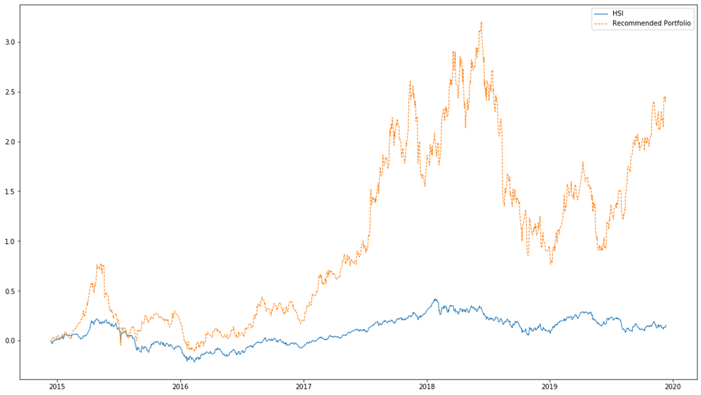

Back Testing Review the historical performance of portfolio vs HSI
Back testing period:
from 12/12/2014 to 12/12/2019
The performance of our portfolio did much better than HSI. Especially, the return of the portfolio had been much higher than that of HSI since 2017.

Slide 15
Improvement

Slide 16

Factors Choosing
We can use the scoring method or regression method for factors selection, which was much more difficult and needed much larger memory space to run the code.
Updates of Stock Compositions
Due to the memory space of our computers and the complexity of portfolio composition in practice, we could not build a sophisticated portfolio with frequent updates of stock compositions.
Scarce Ability of Predicting the Future
The performance results we got were based on history, we could not predict the future with certainty.

Slide 17
Thanks for listening
Q&A

